Slide 1
BREAST IMAGING
DR IRAM SHABIR

Slide 2
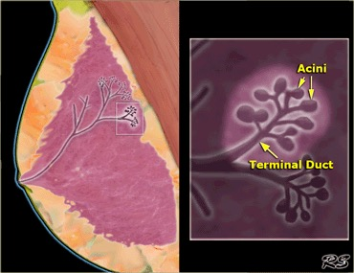

Slide 3
Mammography…
The primary imaging modality for breast
Differentiates tissues based on their density using low-energy ionising radiation.
Compression of the breast provides an even distribution of the tissue, improves contrast of the image, reduces radiation dose and helps remove artefacts.
For standard examination of the breast, two views of are obtained – craniocaudal (CC) and medio-lateral oblique (MLO at a 45° angle).

Slide 4
To evaluate the image two views are vital to differentiate artefacts from true lesions. If an asymmetric density is visible only in one view, it is most likely caused by superimposition of normal breast tissue; real lesions typically appear in both views.
Comparison of new and previous images is essential for detecting pathology, especially in the screening setting, where a subtle change of focal breast density may be the first and only sign of malignancy.

Slide 5
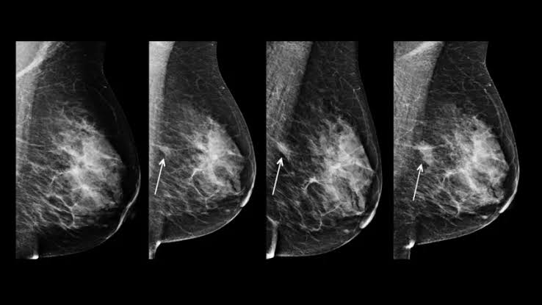

Slide 6
Mammography…
Indications for mammography include:
Breast cancer screening
Assessment of patients with clinical symptoms
Image-guidance for biopsy
Preoperative staging
Preoperative localisation
Therapy monitoring and follow-up

Slide 7
Breast density is classified as..
A. Breasts are almost entirely fatty.
B. There are scattered areas of fibroglandular density.
C. The breasts are heterogeneously dense, which may obscure small masses.
D. The breasts are extremely dense, which lowers the sensitivity of mammography.

Slide 8
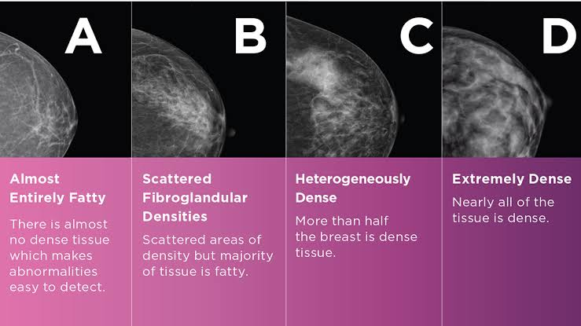

Slide 9
DBT Vs BT evaluation of microcalcification may be limited. Due to the increased number of images, the reading time for a DBT study is longer than for mammography. The radiation dose from DBT (when used as standalone method) is not higher than that of digital mammography

Slide 10
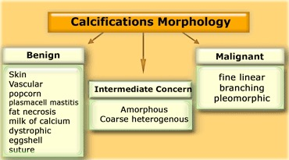

Slide 11
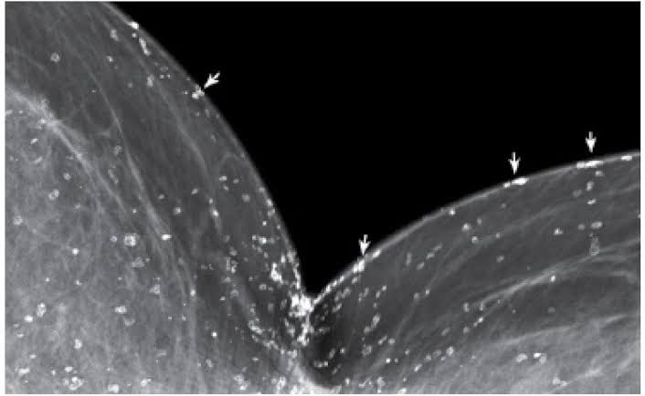
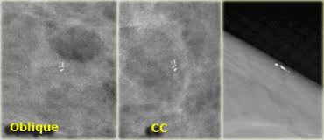
Benign calcifications….

Slide 12
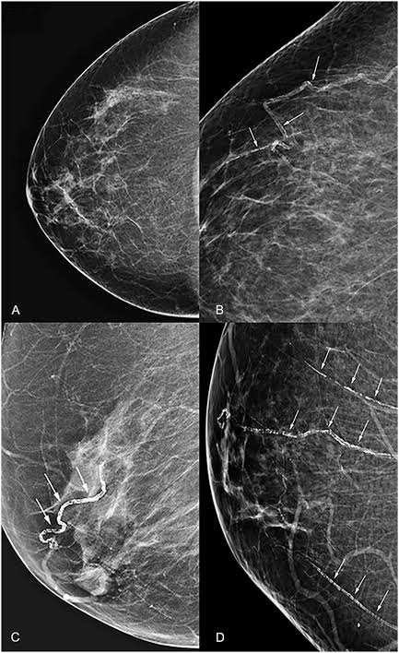
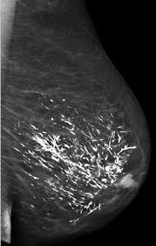

Slide 13
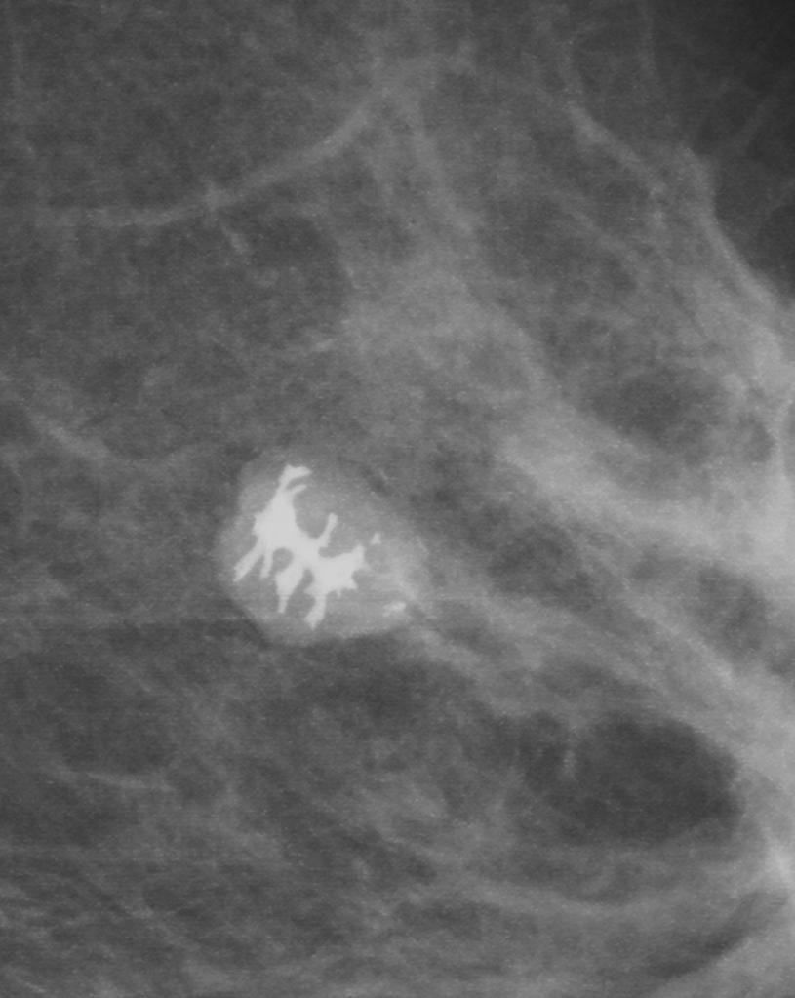
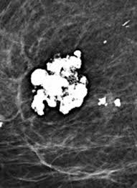

Slide 14
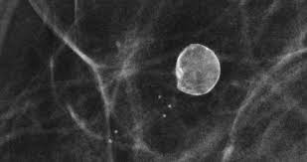
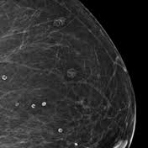

Slide 15
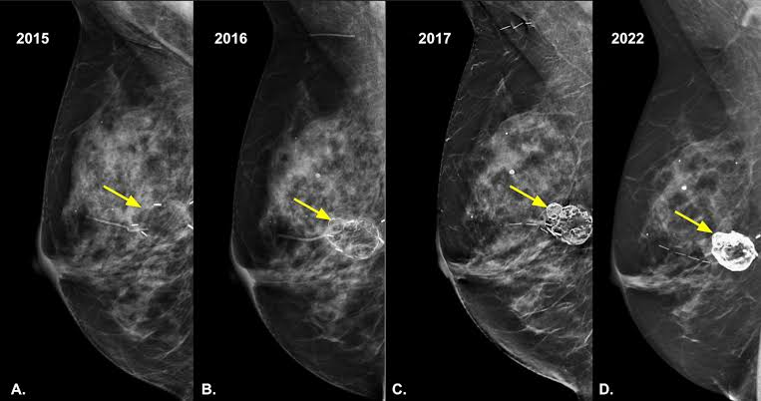

Slide 16
Suspicious calcifications…
coarse heterogeneous: irregular, generally 0.5-1 mm
amorphous: indistinct and/or small ("powdery", "cloud", or "cottony"), such that another specific shape cannot be determined
fine pleomorphic: variable shape ("shards of glass" or "crushed stone"), generally <0.5 mm
fine linear or fine-linear branching: thin (<0.5 mm), linear, branching or irregularly arranged ("casting")

Slide 17
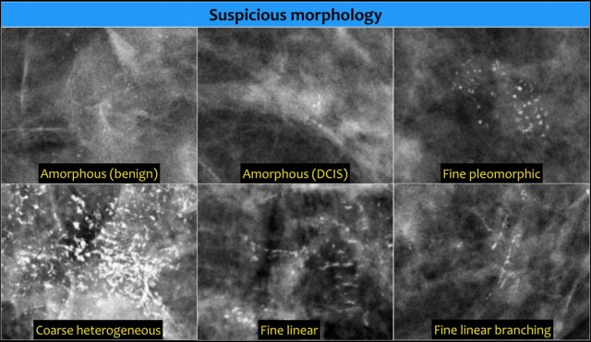

Slide 18
Classification by distribution…
diffuse: scattered randomly throughout the breast; almost always benign
regional: scattered in a larger volume (>2 cm in greatest linear dimension) of breast tissue and not in the expected ductal distribution; malignancy is less likely but the overall evaluation also depends on the morphology
grouped: a cluster of at least 5 calcifications within 1 cm from each other, in an area at most 2 cm in greatest linear dimension; more likely to be malignant with smaller calcific particle sizes (<1 mm) and suspicious shape

Slide 19
linear: calcifications arrayed in a line suggestive of deposition along ducts; suspicious if there is not a characteristically benign appearance such as vascular or large rod-like calcifications)
segmental: calcium deposits in ducts and branches of a segment or lobe; suspicious if not characteristically benign such as large rod-like

Slide 20
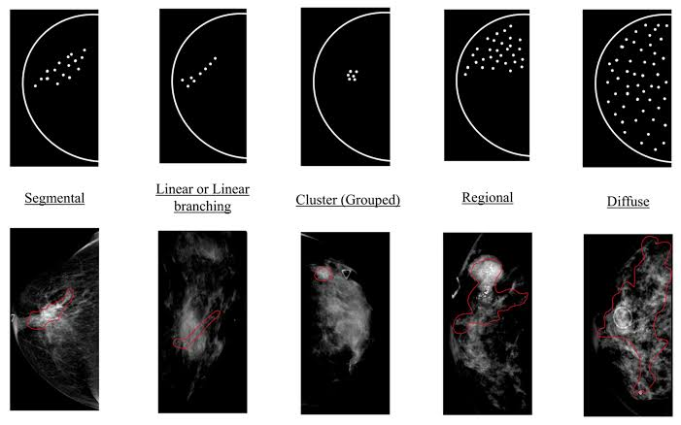

Slide 21
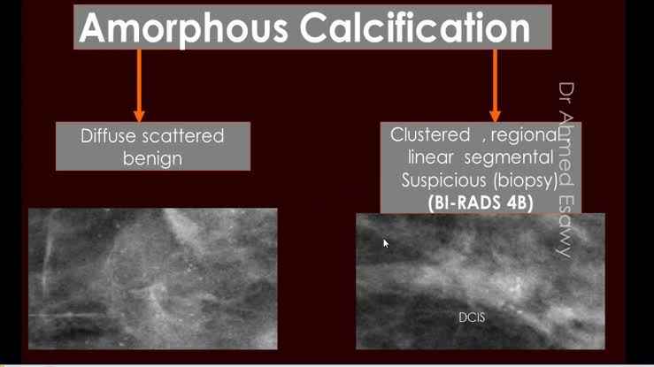

Slide 22
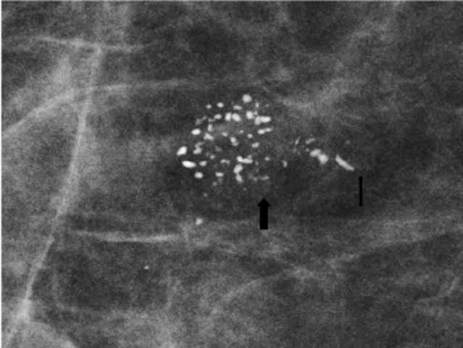

Slide 23
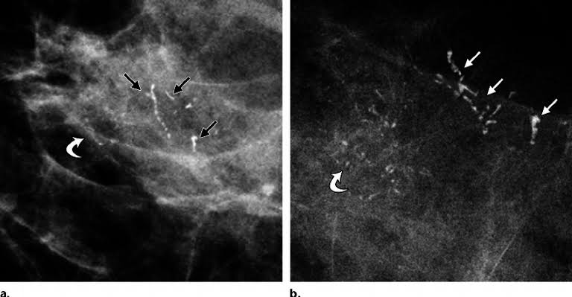

Slide 24
Malignant lesion..
Irregular masses with spiculated margins and a dennsity equal to or higher than the breast parenchyma;
Distortion of the parenchyma or retraction may be a sign of malignancy even if a distinct mass is not visible.
Mammography shows higher sensitivity for ductal carcinoma (79.1–80%) than for lobular carcinoma (67.2–72.1%)
In BRCA mutation carriers, the tumours manifest less frequently as spiculated masses or distortions, and the lesions are frequently well circumscribed mimicking benign disease which results in lower sensitivity of mammography

Slide 25
Microcalcifications are highly suggestive of malignancy if they are amorphous, fine pleomorphic, fine linear with/with- out branching or coarse and heterogeneous.
Distribution following ductal anatomy (linear, segmental or regional) is a suspicious feature
BRCA classification used to stage the breast lesions

Slide 26
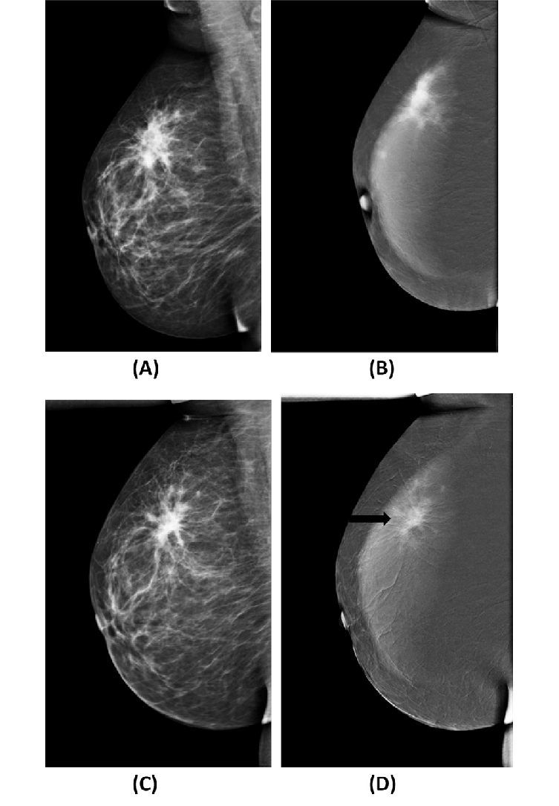

Slide 27
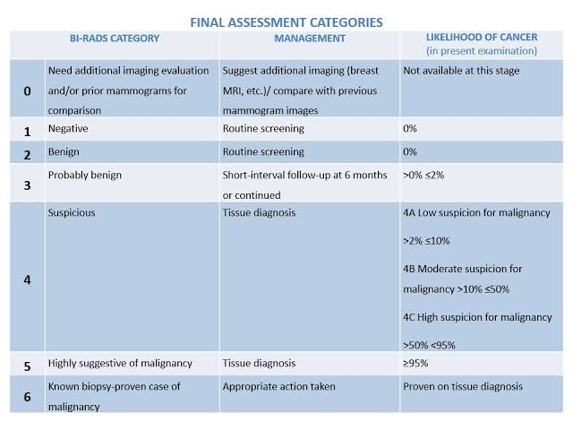

Slide 28
Ultrasound..
Uses high- frequency acoustic waves; For breast imaging, linear transducers with a frequency of 10–12 MHz are recommended
Indications for Breast Ultrasound
-Adjunct to screening mammography
- Confirmation and characterisation of abnormalities found in other modalities
-Axillary staging
-Evaluation of breast implants
- Guidance of interventional procedures in the breast and axilla
- Evaluation of young, pregnant and breastfeeding patients with clinical symptoms

Slide 29
Malignant lesion..
hypoechoic masses
irregular shape.
poorly circumscribed (spiculated or lobulated) margins
orientation non-parallel to the chest wall/skin (taller-than-wide)
posterior shadowing

Slide 30
Benign lesions are usually oval, circumscribed, with a parallel orientation and homogeneous echo pattern with no posterior features

Slide 31
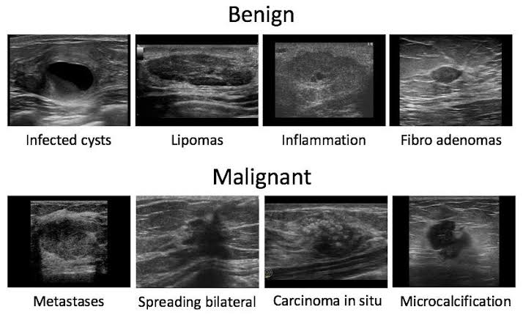

Slide 32
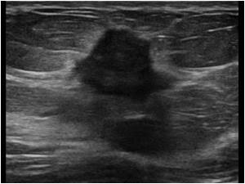
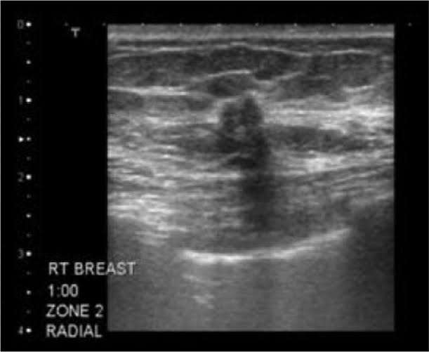

Slide 33
Benign lesion does not require biopsy, follow-up within a short time interval especially in younger women and lesions smaller than 2 cm is suffice.
If there is a marked increase in size or if descriptive characteristics is not typically benign, performed biopsy as some malignant tumours (especially in young women) may mimic benign lesions.
These may include medullary cancers, high-grade cancers or mucinous cancers which can have appearance similar to cysts or fibroadenomas. The finding on Us

Slide 34
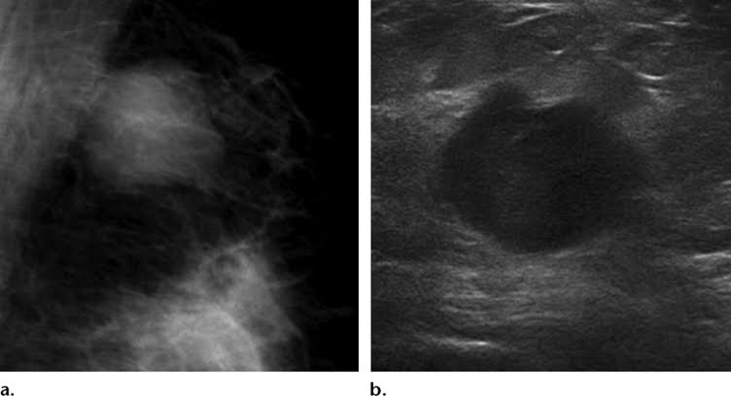
Medullary breast ca on Mmg & Us..

Slide 35
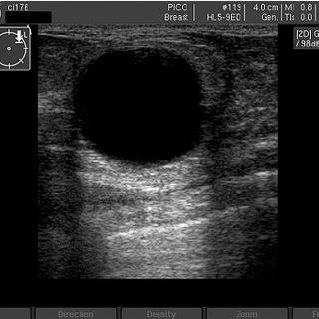
Mucinous tumor on us..

Slide 36
In BRCA mutation carriers, any new focal lesion should be biopsied despite its benign appearance in ultrasound.
Assesing the axilla: cortical thickening (>3 mm) is present especially compression or displacement of the hilum
Uniform cortical thickening may be suggestive reactive changes, immunological/systemic inflammatory disease or haematological malignancy such as lymphoma or chronic lymphocytic leukaemia (CLL)
Ultrasound is also used for guidance of lymph node biopsy and fine needle aspiration

Slide 37
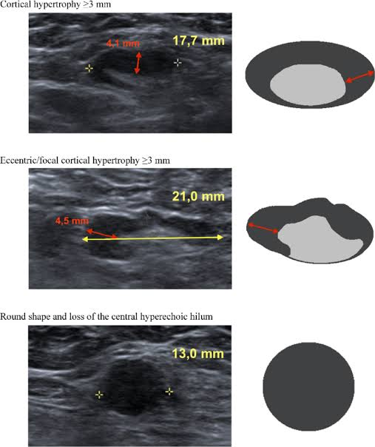
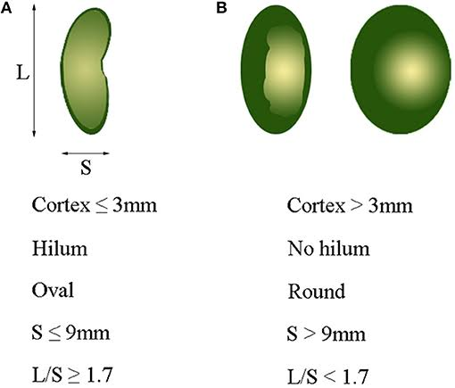

Slide 38
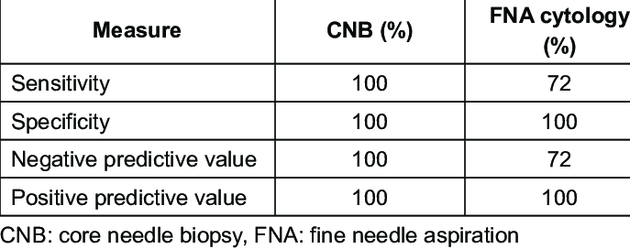

Slide 39
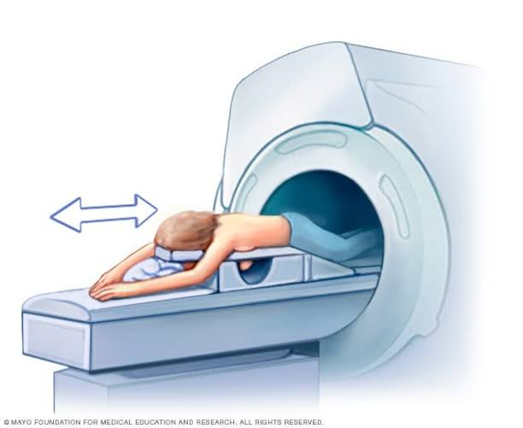
Mri…

Slide 40
MRI…
1.5 Tesla device ;dedicated breast coil; Gadolinium-based contrast media is used
Contraindications to MRI
- implanted pacemakers
-implanted metallic material (e.g. cochlear implants, vascular stents and clips)
- Claustrophobia
-Allergies to MRI contrast media and impaired renal function
-Pregnancy and lactation

Slide 41
Scanning time using the full protocol ranges between 15 and 30 minutes and usually includes:
T2-weighted images (T2WI) with/without fat suppression.
T1-weighted images (T1WI) without contrast.
Dynamic T1WI after contrast media administration – series of scans with duration of 40–60s, 5–8 repetitions, images with/without fat suppression. Image subtraction supports visualisation of areas of contrast uptake.

Slide 42
Malignant lesions tend to enhance early; they are typically seen in the early dynamic T1WI with contrast.
T2WI enhances the signal of fluid; oedema, fluid collections and liquid content of the lesions are easily visible. In T2WI malignant tumours are typically darker, while benign lesions appear brighter

Slide 43
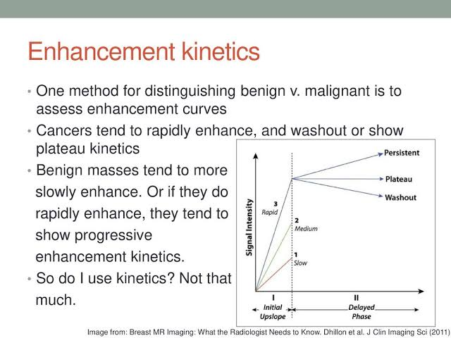

Slide 44
DWI evaluates movement (diffusion) of water molecules through tissue. Diffusion is restricted in malignant lesions due to their high cellularity. The restriction is quantified by the apparent diffusion coefficient (ADC). ADC values can be helpful in differentiation of benign (higher values) and malignant (lower values) lesions and can reduce the number of false positives and unnecessary biopsies [43]. 5 Magnetic resonance spectroscopy (MRS) analyses the chemical content of the lesions. Studies have demonstrated elevated choline content in malignant tumours [44].
Both advanced sequences (DWI and MRS) are not a mandatory part of most MRI protocols, but they can provide useful additional information and increase the diagnostic accuracy of the examination.

Slide 45
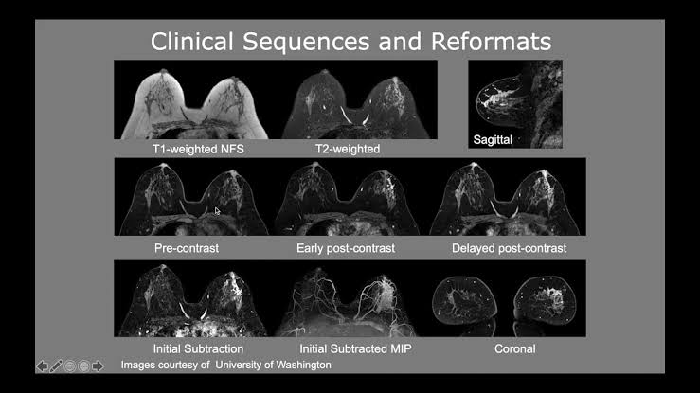

Slide 46
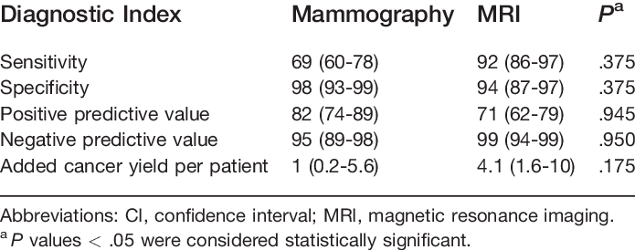

Slide 47
A malignant mass is usually of irregular shape with non- circumscribed margins and heterogeneous internal enhancement . After contrast media administration, there is a rapid inflow in the early phase followed by washout in the delayed phase.
Some malignancies (especially ductal carcinoma in situ) appear as non-mass-like enhancement areas (NMLE)
Benign lesions are typically oval or round in shape, with circumscribed margins and homogeneous enhancement. The uptake of contrast media is slow initially and persistent in the delayed phase. In T2WI benign lesions are usually brighter

Slide 48
Uses of mri
MRI used in assessing
Multicentric and multifocal tumors
Contralateral breast
Lobular carcinoma
Younger women
BRCA positive patients
Assesing skin and chestwall
Nipple evaluation

Slide 49
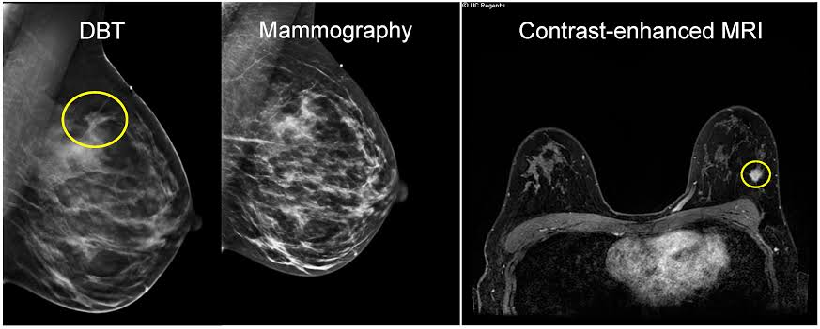
Screening..

Slide 50
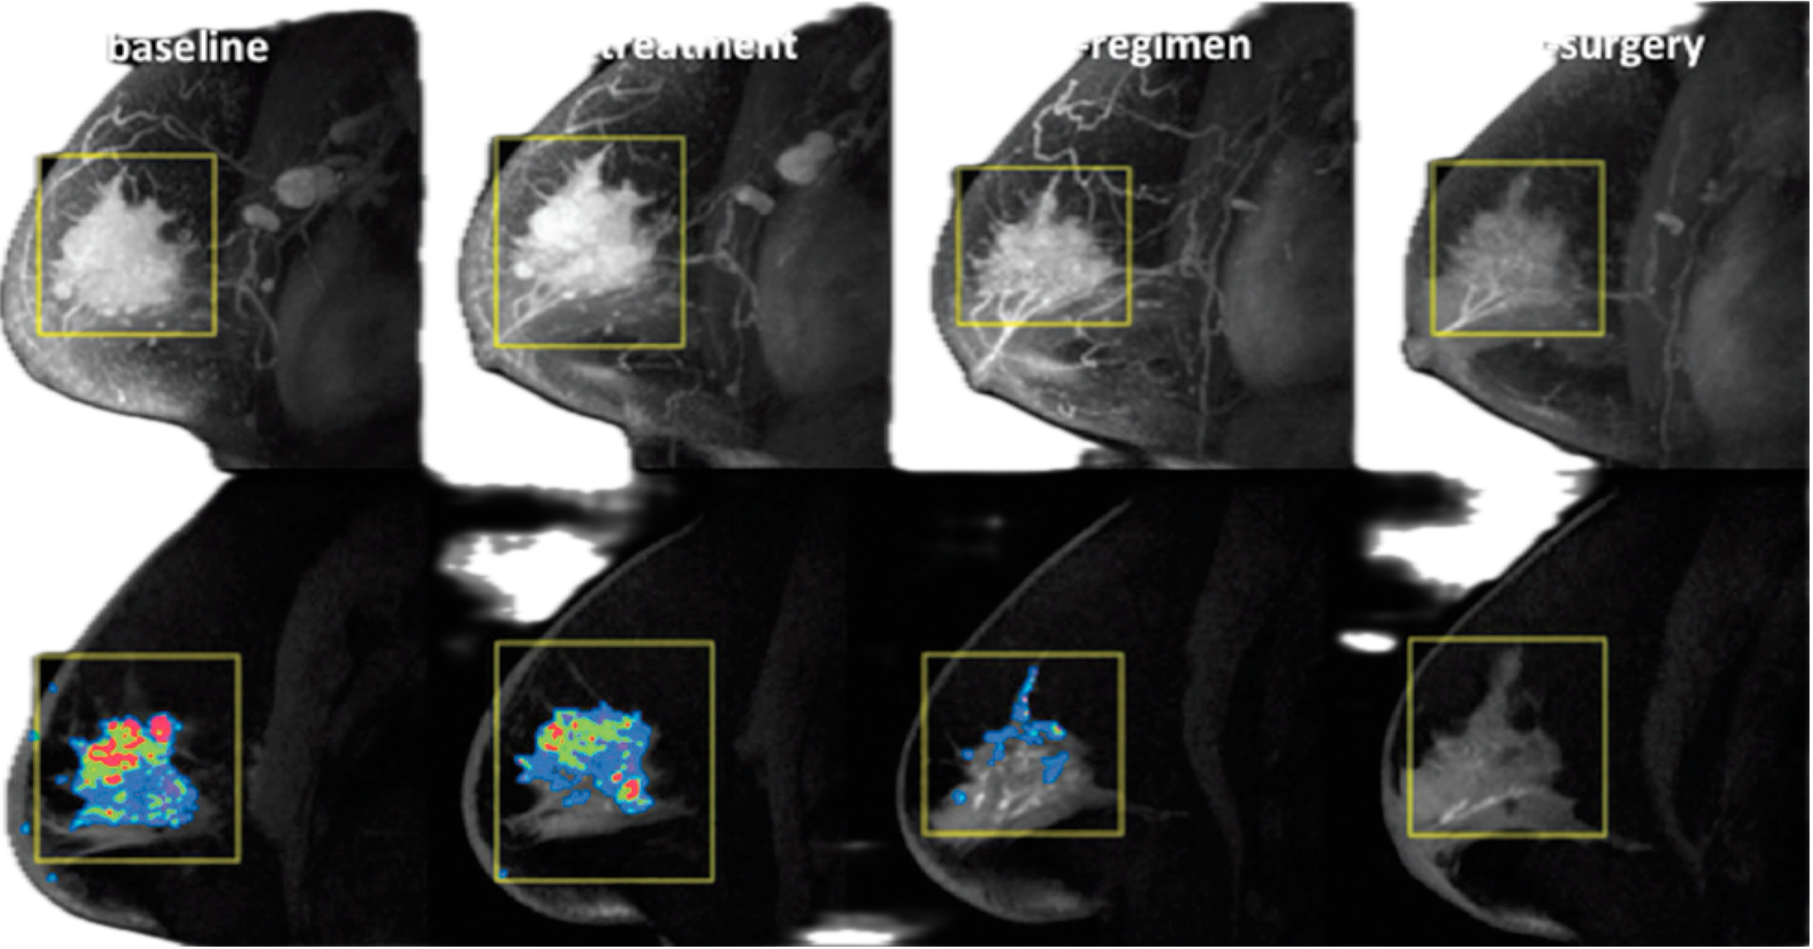
Response to NAT..

Slide 51
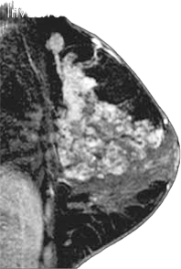
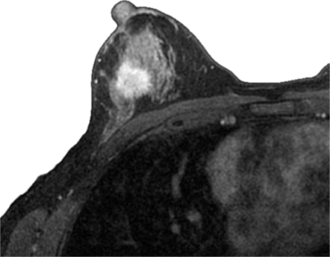

Slide 52
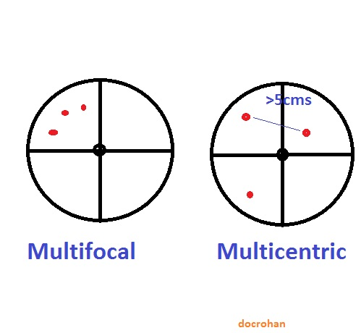

Slide 53
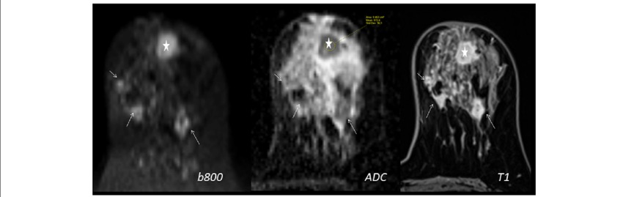

Slide 54
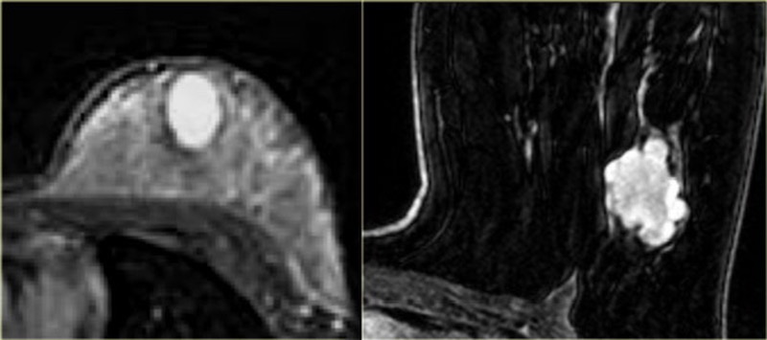

Slide 55
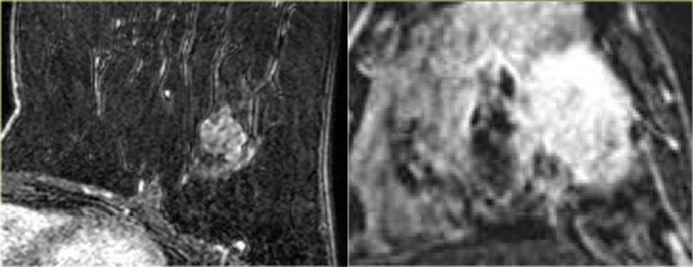

Slide 56
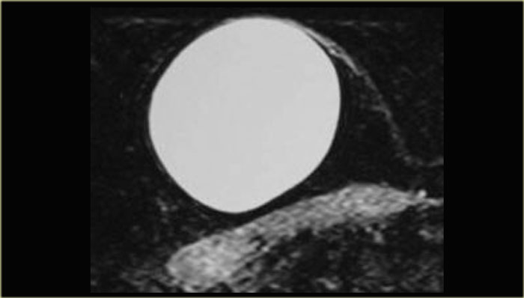

Slide 57
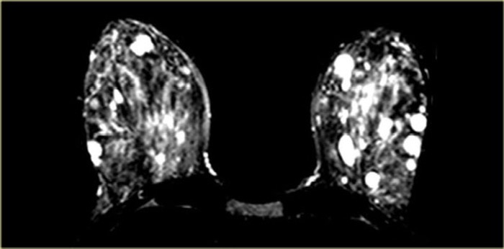

Slide 58
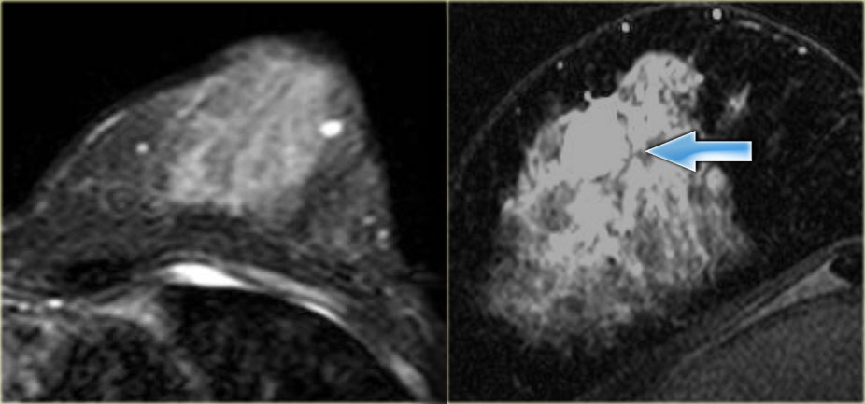
Colloid ca on t2..

Slide 59
Take home message…
The choice of breast imaging depends on the age of the patient, the purpose of the examination, prior imaging findings and the clinical context.
Maximum efficacy achieved by combined use of imaging methods
If a suspicious lesion is seen on us or Mmg its best to biopsy rather than use another imaging modality
Beware of false positive findings on mri. Mri as a screening tool should only be used in high risk patients
The method in which the lesion is best seen should be the one used for biopsy and preoperative imaging

Slide 60


