Slide 1


Breast tumor biology and non-surgical management
26 February 2020
Juan Gouws
General Surgery Registrar Tutorials

Slide 2
Question
Discuss tumor biology and non-surgical management in each case

Slide 3
Discuss tumor biology

Slide 4
Tumor biology
Previously anatomic and histological features (ductal, lobular, grade, lymphovascular involvement etc…) were used to prognosticate and determine treatment
Then in 2000, Perou and Sorlie described subtypes of breast cancer according to different genetic sequences:
luminal A
luminal B
human epidermal growth factor receptor 2 (HER2) enriched
basal- like
Claudin low
Normal like
Nadia Harbeck et al. Breast Cancer. NATURE reviews.
Disease primer. 2019 (5:66)

Slide 5
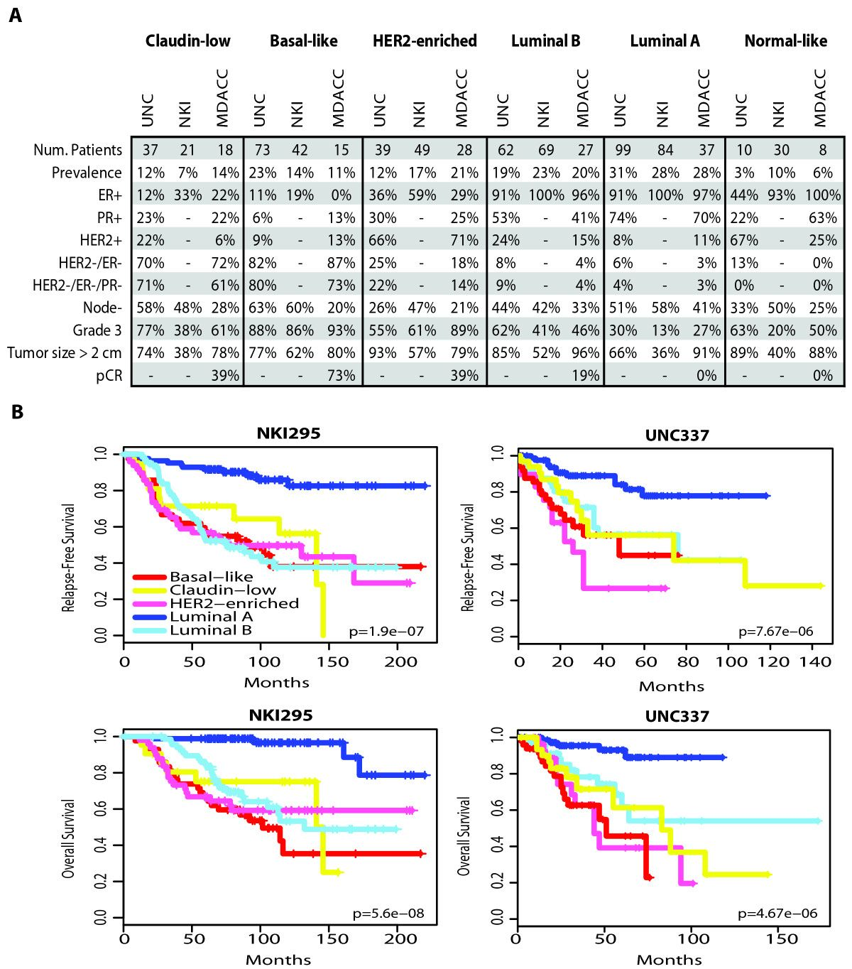
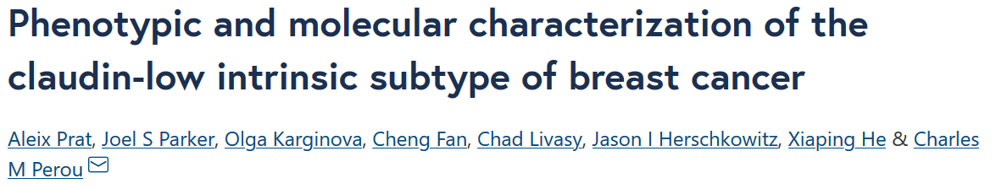
Q

Slide 6
Tumor Biology
shifted clinical management of breast cancer from tumor burden to biology centred approaches
molecular characteristics of tumors provide more specific characterization offering additional information regarding
prognosis
tailored treatment

Slide 7
Tumor biology
Complete molecular profiling (genetic testing) is not feasible on individual patients
Immunohistochemistry is used as a surrogate and is generally comparable with the genomic profile

Slide 8
Immunohistochemistry
Immuno
Antigen antibody based test
Histo
Performed on a histological specimen
Chemistry
Creates a chemical reaction to indicate that the test is positive / negative

Slide 9
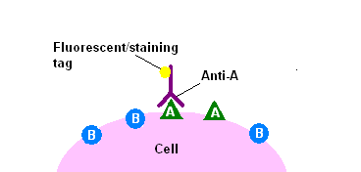
Immunohistochemistry

Slide 10
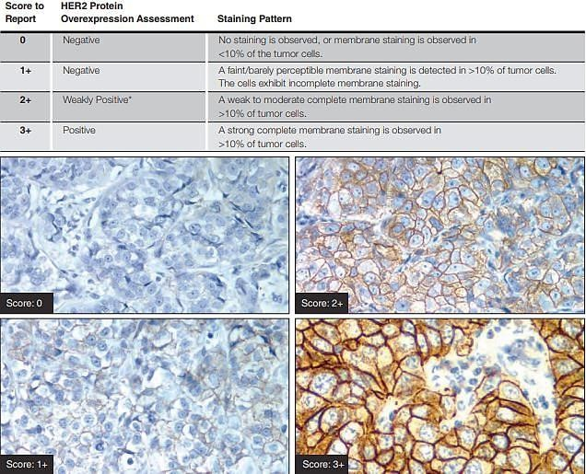
Immunohistochemistry

Slide 11
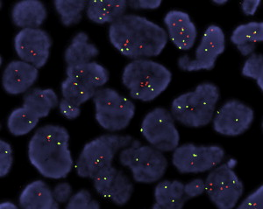
Immunohistochemistry (FISH)
Fluorescent in situ hybridization

Slide 12
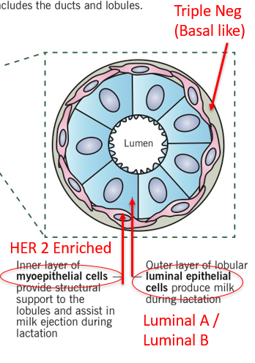
Surrogate markers
Luminal A (40% of Br Ca)
ER strongly pos (>5/8) and PR pos, HER 2 neg, low ki67 (depends on lab, at GSH <20%)
Luminal B (20% of Br Ca)
Her 2 pos / ER pos, any ki67
Her 2 neg / ER pos, high ki67
HER 2 enriched (13-15% of Br Ca)
ER neg, PR neg, HER 2 + pos
Triple neg (10-15% of Br Ca)
ER neg, PR neg, HER 2 neg

Slide 13
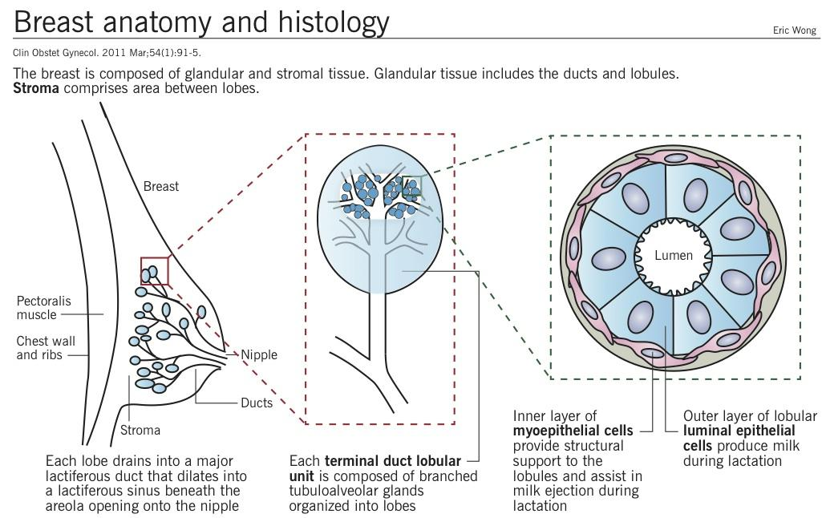
Q
Triple Neg
(Basal like)
HER 2 Enriched
Luminal A /
Luminal B

Slide 14
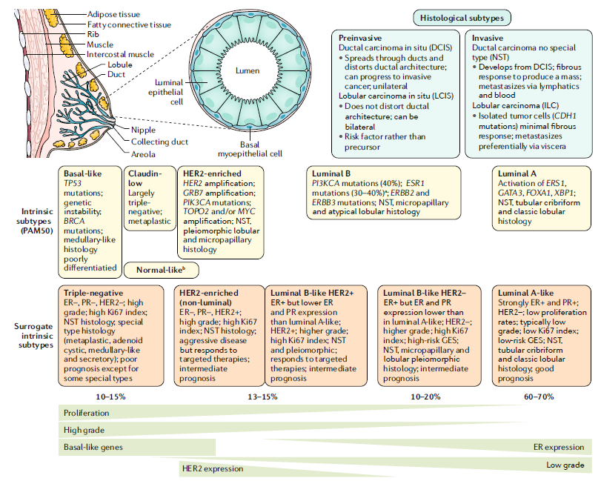
Q
Immuno-
histo
chemistry (IHC)
Ki67
Worsening prognosis

Slide 15
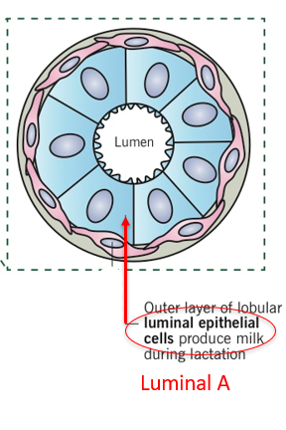
LUMINAL A (ER+ and PR+ / HER2 neg/ low ki67)
40%
Usually low grade tumors
Best response to endocrine therapy
Best prognosis compared to the other groups

Slide 16
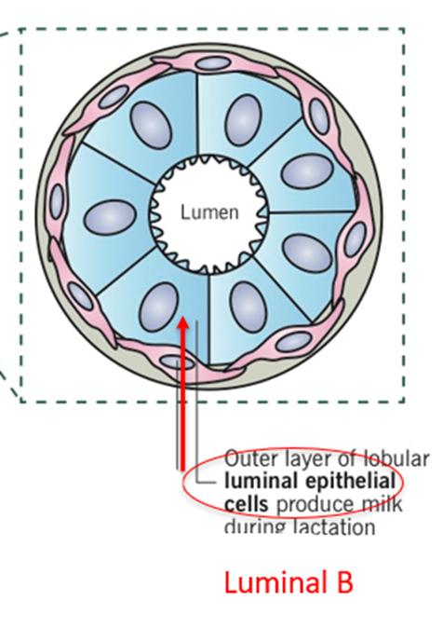
LUMINAL B (Her 2 pos and ER pos / any ki67) (Her 2 neg / ER pos / high ki67)
20%
More aggressive than Luminal A
Prognosis
WORSE than Luminal A
BETTER than triple neg / HER 2 enriched
Responsive to endocrine therapy
Better response to chemo than Luminal A tumors

Slide 17
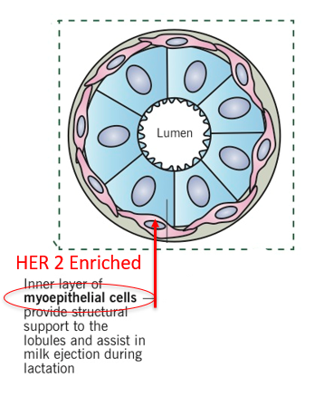
HER 2 enriched (ER-, PR- / HER 2+)
10-15%
Human Epidermal (growth factor) Receptor 2
Her 2 Immunohistochemistry score:
0-1 = Neg
2 = equivocal => FISH
3 = Pos
Before targeted therapy was introduced
Short time to relapse
Poor prognosis
Decr. Survival
Trastuzumab (Herceptin)
monoclonal antibody against the HER2 protein
significantly improved outcomes

Slide 18
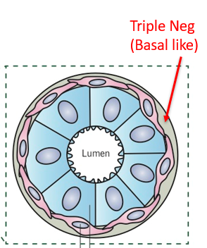
Triple Negative (ER - / PR - / HER 2 - )
10-20%
Most aggressive of all subtypes
Frequently affects younger patients
“Triple negative paradox”
No hormone or HER 2 receptors therefore no response to trastuzumab or endocrine therapy
However, responds well to chemo
20-45 % pathological complete response (pCR) on neoadjuvant
If TNBC achieves pCR then survival = to that of non TNBC
But non responder do poorly

Slide 19
Discuss Non-Surgical Management

Slide 20
Endocrine therapy
Recommended in all patients with ER positive invasive cancers

Slide 21
Endocrine therapy (SERM’s)
Premenopausal
Tamoxifen 20mg DLY PO for 5 yrs
Selective Estrogen Receptor Modulators (SERM)
Competitive ER antagonists
Reduces recurrence and death in premenopausal and postmenopausal women with ER-positive tumors
SE: hot flashes, vaginal dryness, thromboembolic events, endometrial cancer (postmenopausal women)
Extended use: 5 yrs plus a further 5 yrs does reduce risk of recurrence and increases survival
But SE often limiting
Consider this in high risk women:
>4 pos LN’s
Tolerating Tamoxifen well

Slide 22
Endocrine therapy (Aromatase inhibitors)
Recommended for post menopausal women
Decreased side effects
Better tolerated
Improved effectiveness
Anastrazole 1mg DLY PO
Aromataze inhibitor
block the conversion of adrenally synthesized androgens to estrogen
SE: Osteoprosis
Give additional Vit D 5000IU weekly PO and Calcium 1200mg dly PO
AI at GSH is limited to:
Pts who progressed on tamoxifen
Intolerable side effects of tamoxifen
contra-indication to tamoxifen
endometrial hyperplasia/bleeding

Slide 23
Endocrine therapy (OFS)
Ovarian Functional Suppression (OFS) therapy
Balance the gains in disease free survival against the risks of early menopause
Consider in high risk pts
age<35y
>4 LN pos
Only if patient remains premenopausal after chemo
EBRT15Gy in + Tamoxifen (AI in literature)

Slide 24
HER 2 pos TRASTUZUMAB (Herceptin)
Recombinant monoclonal antibody directed against the HER2 protein (In use since 1998)
Not available in state
Consider use (in conjunction with Chemo) for:
tumors larger than 1 cm in diameter
node-positive disease
5 -10 mm tumor and micro-metastatic nodal disease.
The optimal duration of trastuzumab = 1 year of therapy

Slide 25
Chemotherapy
NB: carries a 2% mortality risk on its own
Indications:
Triple negative
HER 2 pos (plus trastuzumab)
Luminal A (usually poor response)
≥ Stage 3 (≥ 4 positive LN’s, T4, T3N1)
Luminal B (uncertain response therefore calculate)
≥ Stage 3
Likely to respond based on
Breast.Predict.nhs.uk (>3% 5 yr survival / >5% 10yr survival)
Mammaprint / Oncotype DX

Slide 26
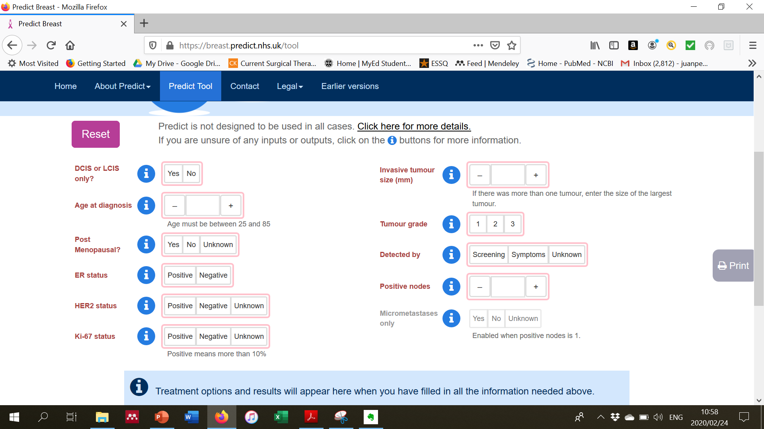
a

Slide 27
NEOadjuvant Chemotherapy
Indications:
Downsize for BCS
Her 2 pos
Triple neg
Locally advanced
Sequence
Chemo for 3 cycles : then reassess
Good response = complete chemo
Poor response = change to second line chemo or expedite surgery

Slide 28
Chemotherapy
Regimens
Primarily we use AC 4 + P 4
TC 4 (>70y, anthracycline contraindicated)
(luminal A, poor chemo candidate)
AC = Adriamycin (Doxorubicin) / Cyclophosphamide
P = Paclitaxel
TC = Docetaxel / Carbaplatin
4 = 4 cycles (of 3wks)

Slide 29
Chemotherapy
Must start within 6-12 wks of surgery
Trastuzumab and Adriamycin both cardiotoxic, finish Adriamycin then go onto trastuzumab
Sequence:
Chemo (and +- Trastuzumab)
then Radiation,
then Hormonal therapy

Slide 30
Radiotherapy
Tumor biology plays little role in decision making regarding radiotherapy
Indications for radiotherapy are:
All BCS
Stage 3 disease
All pN2 (≥ 4LN’s)
T4
T3N1
1-3LN’s with concerning features
Lymphovascular invasion
<40 yo
positive nodal ratio >20%
<10 LN’s sampled
Gr 3
Non luminal dz

Slide 31
Radiotherapy
BCS no nodes
WBRT
BCS with pos nodes (or 3 pos nodes on a SLNB) or 1-3 nodes with concern
WBRT + axilla + Supraclav
Mastectomy (T3N1,T4; pos margins)
Chest wall only
Mx with N2 or 1-3 nodes with concern
Chest wall + axilla + Supraclav

Slide 32
Radiotherapy
Chest Wall: 2.67Gy x 15 = 40.05Gy
Supraclav: 2.67Gy x 1
At GSH a boost is given to:
women <50y
positive margin in whom repeat surgery is not feasible
dose: 2.67Gy x 4 (extra dose to bed after 15 doses mentioned above finished)

Slide 33
Summary
Intrinsic classification | Hormonal | Trastuzumab | Chemo | RadioRx Chest wall / WBRT | RadioRx Axilla / Supraclav
Luminal A | YES | NO | Stage 3 | BCS T3N1,T4 Positive Margins 1-3 LN no concerning features* | N2 1-3 pos nodes on SLNB 1-3 nodes with concerning features*
Luminal B HER 2 neg | YES | NO | Stage 3 < Stage 3 but Predict / oncotypeDx show benefit
Luminal B HER 2 pos | YES | YES | YES(neo)
HER 2 enrich | NO | >1cm >5mm with LN micromets | YES(neo)
Triple neg | NO | NO | YES(neo)
*Concerning features:Lymphovascular invasion, <40 yo, positive nodal ratio, >20% , <10 LN’s sampled, Gr 3,Non luminal dz

