Slide 1
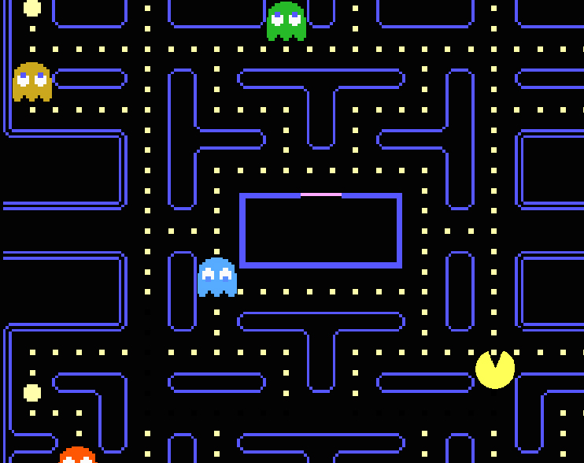
Hungry Bone Syndrome
Tomé Mendes
24 October 2022

Slide 2
Outline
Physiology

Slide 3
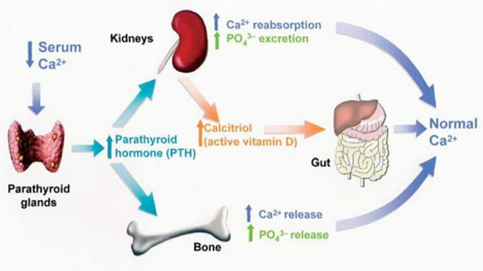
Notes:
https://www.google.com/url?sa=i&url=https%3A%2F%2Fpharmaceutical-journal.com%2Farticle%2Fld%2Fremedying-calcium-and-phosphate-problems-in-chronic-kidney-disease&psig=AOvVaw1MERr-7JesLXQR5kXr6HXJ&ust=1666627008919000&source=images&cd=vfe&ved=0CA0QjRxqFwoTCMDwvcjb9voCFQAAAAAdAAAAABBi

Slide 4
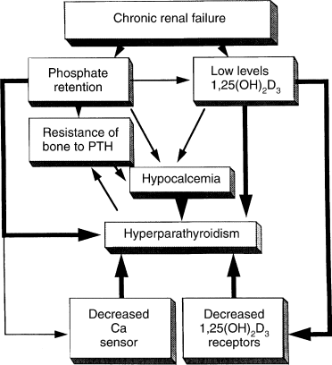
Notes:
https://els-jbs-prod-cdn.jbs.elsevierhealth.com/cms/attachment/2068400052/2067340564/gr1.gif

Slide 5
Hungry Bone Syndrome
Hypocalcaemia post parathyroidectomy due to acute reversal of the PTH-induced contribution of bone to maintenance of the serum calcium concentration
Net increase in bone remodeling and formation
Calcium, phosphate and magnesium
More marked in secondary with ESKD

Slide 6
Incidence and risk factors
Poorly defined diagnostic criteria
13-20% post parathyroidectomy in ESKD
Predictors of HBS
Large volume adenoma/high level PTH
Long duration of secondary HPTH
Elevated ALP
Pre-existing osteoporosis/age

Slide 7
Features
Hypocalcaemia
Hypophosphatamia
Hypomagnesemia
Hyperkalaemia

Slide 8
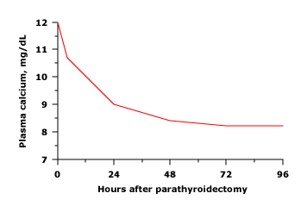
Hypocalcaemia
Onset within 2-3 days
Variable Duration
Tetany
Trosseau’s sign
Chvostek’s sign
Seizures
Cardiovascular instability
Hypotension with decreased myocardial contractility
Prolonged QT interval
Papilloedema
Benign intracranial HPT
Psychiatric

Slide 9
Hypocalcaemia - treatment
First days are greatest risk
Ionized calcium preferred - more reliable in patients with CKD
Oral calcium (2-4g elemental per day)
IV indicated if:
Rapid and progressive reduction
Symptomatic hypocalcaemia
Ionized calcium < 1.0
Predicted by:
High Pre-op PTH
ALP

Slide 10
IV Calcium replacement
Can be done during dialysis
Calcium gluconate better tolerated peripherally
Local vein irritation with calcium solution > 200 mg/dL
Loading with 1-2g calcium gluconate in 50ml 5% Dextrose over 10-20minutes
10% infusion (1mg/ml) – 900mg elemental calcium/1000ml 5% dextrose water
Initial infusion of 50ml/hour
?Risk of fluid overload in ESKD
Cannot mix with phosphate or bicarbonate

Slide 11
Vitamin D Supplementation
Important for patients with ESKD on dialysis
Oral supplementation should be chronic
IV Calcitriol may be considered
May suppress remaining Parathyroid tissue
Continued until calcium is stabilised

Slide 12
Hypophosphatemia
Falls from high to high normal in Secondary HPTH
Decreased bone resorption and increased formation
Clinical:
Bone and mineral metabolism
Decreased calcium and Mg absorption in distal tubules
Calciuria
Rickets and osteomalacia
Extraskeletal
Decreased intracellular ATP
Impaired contractility
Replacement should be avoided while calcium is low (Risk of binding)

Slide 13
Hypomagnesemia
More common in primary
Results in refractory hypocalcaemia
Reduces PTH secretion
Increases PTH Resistance
Clinical
Neuromuscular
Cardiovascular
Abnormalities in Calcium
Hypokalaemia

Slide 14
Hyperkalaemia
80% of dialysis patients undergoing parathyroidectomy

Slide 15
Prevention
Vitamin D supplementation
One-Alpha = alfacalcidol - Activated Vitamin D
Calcitriol supplementation
IV Calcitriol 3-5 days pre-operative may reduce post-operative hypocalcaemia
Pre-operative bisphosphonates
Inconclusive research

Slide 16
Possible changes
Pre and post-operative Mg monitoring

